Slide 1
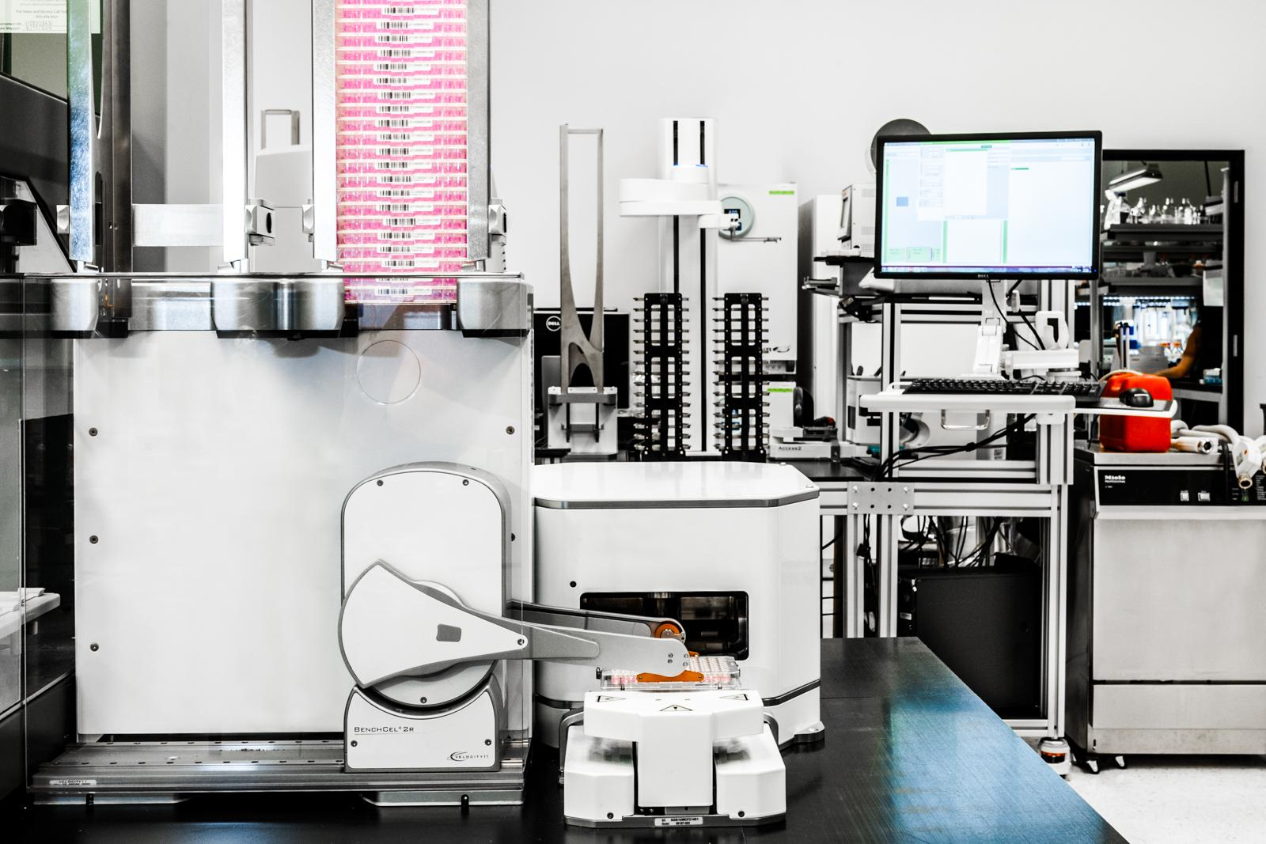

DNA Specifications and Codon: Expressing Combinatorial Designs at Scale
Zach Palchick

Slide 3
About Zymergen
Designers/
Development Scientists
The Factory

Slide 4
What’s the problem
Can express large design spaces
Compact format
Transferable
Structure preserving

Slide 5
DNA Specifications
Nested trees of functions
Leaves are collections of DNA sequences
Internals are string manipulating operations
Similar to an Abstract Syntax Tree

Slide 6
Abstract syntax trees 101
x = (1 * 2) + (3 * 4)
x = (2) + (3 * 4)
x = (2) + (12)
x = 2 + (12)
x = 2 + 12
x = 14

Slide 7
Algebra can be modeled as an AST
x = (1 * 2) + (3 * 4)
+
*
*
1
2
3
4

Slide 8
Evaluating ASTs
+
*
*
1
2
3
4

Slide 9
Evaluating ASTs
+
2
*
3
4

Slide 10
Evaluating ASTs
+
2
12

Slide 11
Evaluating ASTs
14

Slide 12
DNA Specifications are ASTs
concat()
[“AA”,
“CC”]
concat()
Promoters
[“GG”,
“TT”]
[“AAAA”,
“CCCC”]
CDSs
Terminators

Slide 13
DNA Specifications are ASTs
concat()
[“AA”,
“CC”]
[“GGAAAA”,
“TTCCCC”]
Promoters
CDSs + Terminators

Slide 14
DNA Specifications are ASTs
[“AAGGAAAA”,
“CCTTCCCC”]
Promoters + CDSs + Terminators

Slide 15
ASTs let us preprocess structure
concat()
[“AA”,
“CC”]
concat()
Promoters
[“GG”,
“TT”]
[“AAAA”,
“CCCC”]
CDSs
Terminators

Slide 16
ASTs let us preprocess structure
Emit homology arms
concat()
[“AA”,
“CC”]
Calculate overlap regions
concat()
Promoters
[“GG”,
“TT”]
[“AAAA”,
“CCCC”]
CDSs
Terminators

Slide 17
ASTs let us preprocess structure
concat()
[“AA”,
“CC”]
[“GGAAAA”,
“TTCCCC”]
Promoters
CDSs + Terminators

Slide 18
ASTs let us preprocess structure
Calculate overlap regions
Emit homology arms
concat()
[“AA”,
“CC”]
[“GGAAAA”,
“TTCCCC”]
Promoters
CDSs + Terminators

Slide 19
ASTs let us preprocess structure
[“AAGGAAAA”,
“CCTTCCCC”]
+ Homology arm list…

Slide 20
Functions can be parametric
concat[*]()
[“AAGGAAAA”,
“CCTTCCCC”]
[“AA”,
“CC”]
[“GGAAAA”,
“TTCCCC”]
concat[x]()
[“AAGGAAAA”,
“AATTCCCC”,
“CCGGAAAA”,
“CCTTCCCC”]
[“AA”,
“CC”]
[“GGAAAA”,
“TTCCCC”]

Slide 21
Codon: Promoter Swapping
replacePromoter[x](locateGenes(hostStrain, "YFG*"), promoters)

Slide 22










Codon: Promoter Swapping
YFG1
YFG2
replacePromoter[x](locateGenes(hostStrain, "YFG*"), promoters)

Slide 23
How well do DNA Specifications work?

Slide 24
Demonstration of mapping
x = (1 * 2) + (3 * 4)
Promoters x CDSs x Terminators
concat[x]()
+
*
*
concat[x]()
Promoters
1
2
3
4
CDSs
Terminators

Slide 25
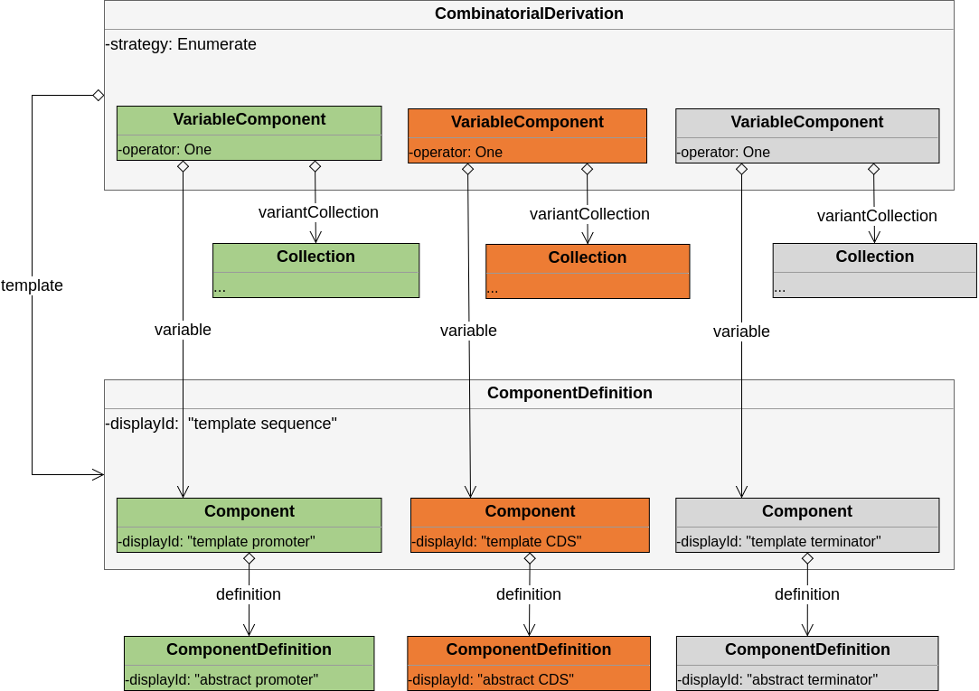
Demonstration of mapping

Slide 26

Thank You
Zach Palchick - palchicz@zymergen.com

